Slide 1

SPEAK
UP
EMOTIONS IN
THE SPEECH
Vladislav Serkizyuk & Oleksandr Galushko

Slide 2
00
Python 3 as a preferred language for machine learning
and natural language
processing (NLP)

Slide 3

PROS FOR USING PYTHON IN MACHINE LEARNING AND NLP
1
2
3
READABILITY AND EXPRESSIVENESS
EXTENSIVE LIBRARIES AND FRAMEWORKS
DATA SCIENCE CAPABILITIES
Python's syntax is clean and readable, making it easier for developers to express complex ideas concisely
Python boasts a rich ecosystem of libraries and frameworks specifically designed for machine learning and NLP
Python's popularity in data science aligns well with the requirements of machine learning and NLP projects.

Slide 4
01
The materials used in the project include such as libraries, datasets and additional sources are following:

Slide 5
Pandas
NumPy
Scikit-learn
Pandas provides data structures like DataFrame and Series, making it easy to handle and analyze structured data.
NumPy is a fundamental package for scientific computing with Python.
Scikit-learn is a machine learning library that provides simple and efficient tools for data analysis and modeling.
Spacy
Whisper
Souddevice, PyDub
spaCy is a natural language processing (NLP) library that simplifies tasks such as tokenization, part-of-speech tagging, and entity recognition
Whisper converts spoken language into written text, facilitating the processing of audio data.
Sounddevice is used for recording audio, while PyDub provides tools for audio file manipulation.

Slide 6
10
Providing
the required dataset for NLP

Slide 7
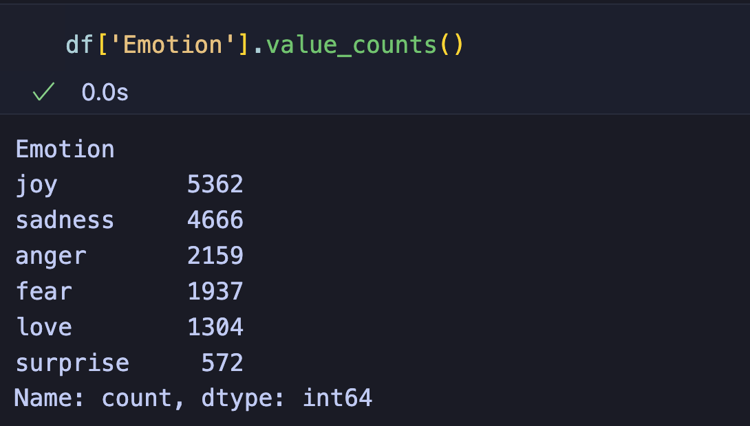
DATASET
The information for training the project's algorithm came from a place called Kaggle, and specifically from a data-set named "Emotions Dataset for NLP" I used a part of the dataset called "train.txt", which you can find on Kaggle's website at this link.
To see the total count for the representation of the mentioned dataset using Pandas library the following code will present the output:

Slide 8

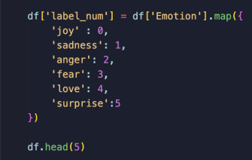
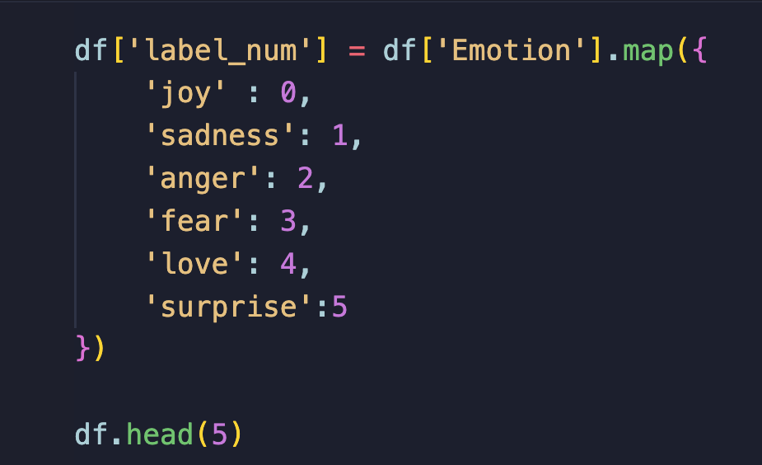
ENUMERATING EMOTIONS
Machine learning algorithms typically work with numerical data. Assigning numerical values to emotions allows the model to process and analyze the data more effectively. And to organize our code for the future learning we must add the specific numeration for each of the emotions. The numerical representation makes it easier to evaluate the model's performance using metrics like accuracy, precision, recall, and confusion matrices. It also simplifies the interpretation of model predictions. This is an incredibly crucial part of the whole process

Slide 9
11
Training
the
model

Slide 10
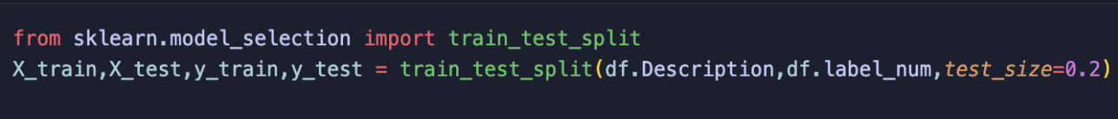

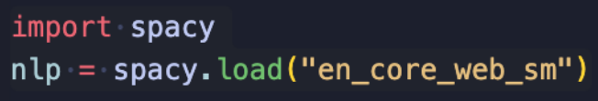
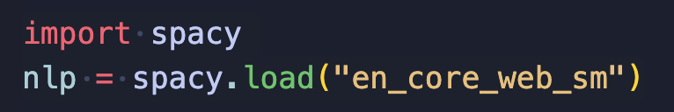
COLLECTING THE DATA
The train_test_split function is used to split the dataset into training and testing sets. The training data (X_train and y_train) are used to train the machine learning model, while the testing data (X_test and y_test) are used to evaluate the model's performance.
This line imports the spaCy library into your Python script or Jupyter Notebook.
spaCy is a natural language processing (NLP) library that provides pre-trained models and tools for processing and understanding human language.
This line initializes a spaCy language processing pipeline using the English language model named "en_core_web_sm." The "sm" in the model name stands for "small," indicating that it's a smaller and faster model suitable for basic NLP tasks.

Slide 11

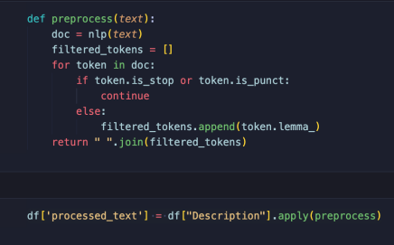
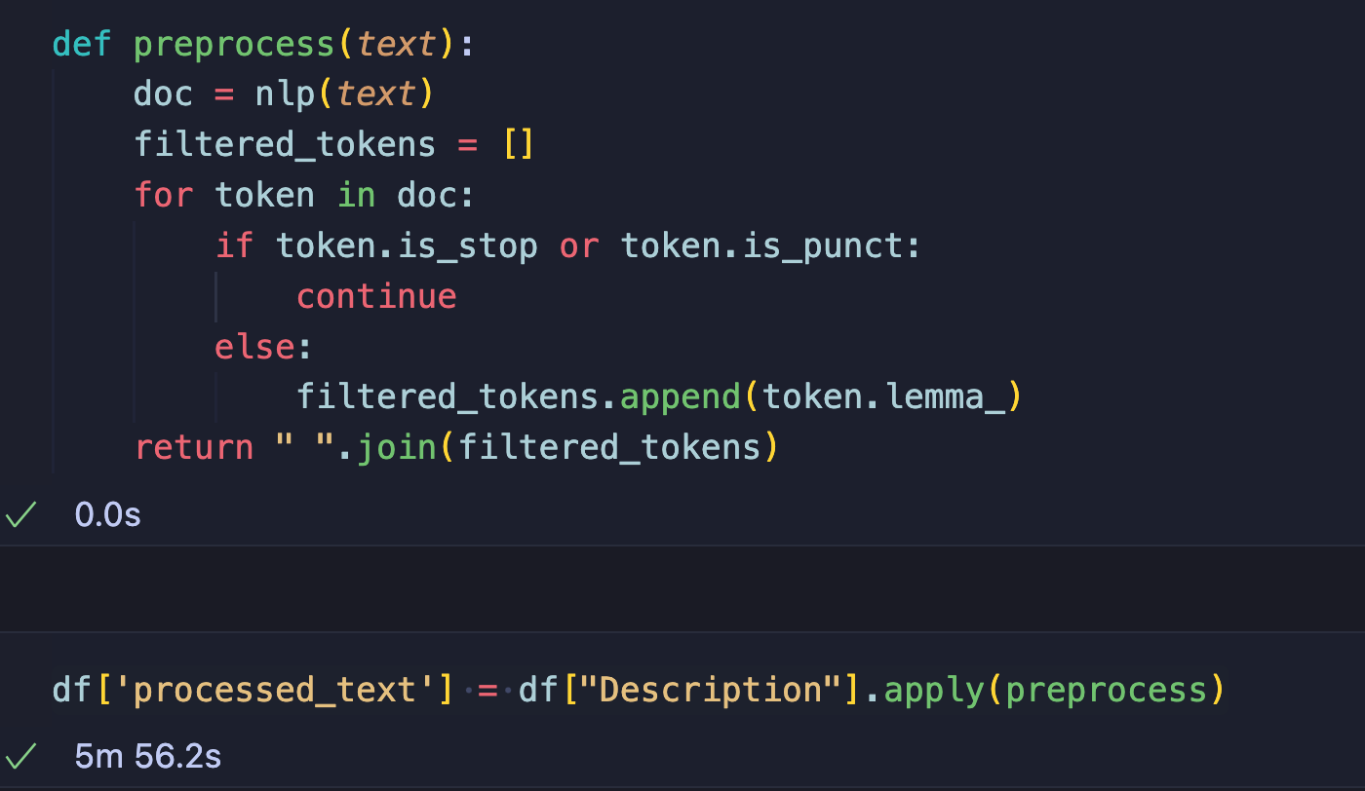
Tokenization with spaCy
doc = nlp(text): The input text is processed using spaCy's language model (nlp). This step tokenizes the text, meaning it breaks it down into individual words or tokens and performs other linguistic analyses
Filtering Stop Words and Punctuation
The function then iterates through each token in the processed document (doc). if token.is_stop or token.is_punct:: Checks if the token is a stop word or punctuation. If it is, the token is skipped (not included in the filtered output).
Lemmatization
filtered_tokens.append(token.lemma_): If the token is not a stop word or punctuation, its lemma (base form) is appended to the list of filtered_tokens.
Joining Tokens
return " ".join(filtered_tokens): The list of lemmatized tokens is joined into a single string, where tokens are separated by spaces. The resulting string is then returned as the preprocessed text.

Slide 12
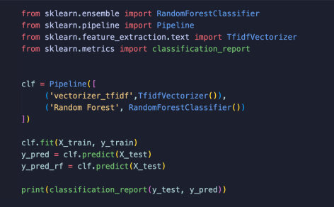
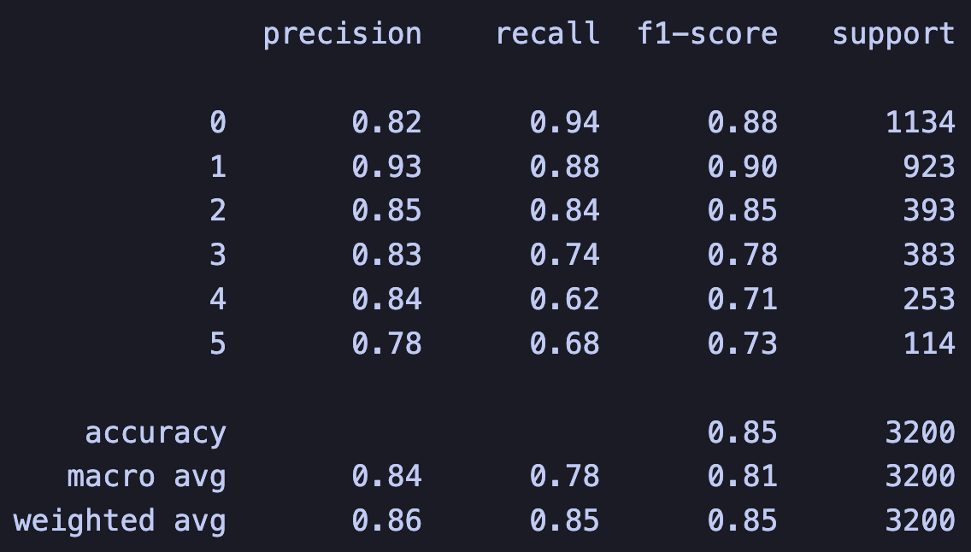
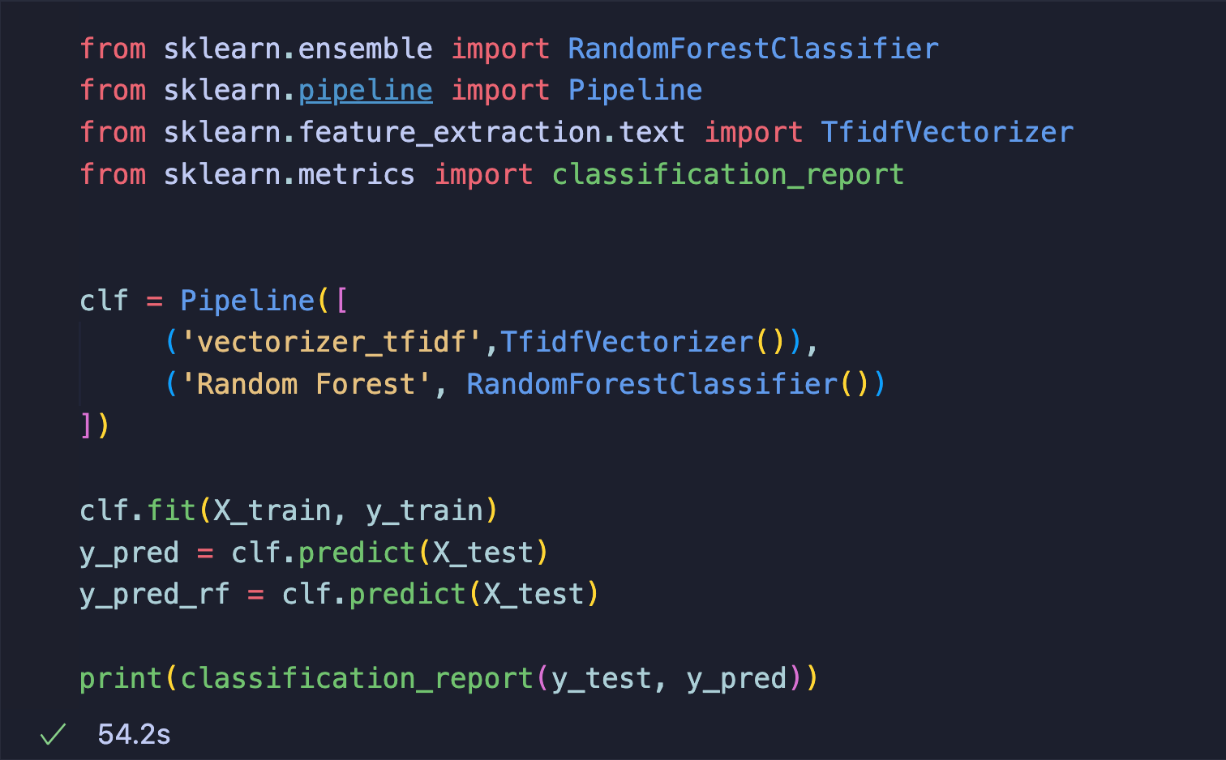
Training the model
1
First we import libraries from Scikit-learn.
2
3
The training with function .fit():
Then goes clf:
- The first step is TfidfVectorizer, which converts a collection of raw documents to a matrix of TF-IDF features.
- The second step is RandomForestClassifier, which is an ensemble of decision trees used for classification.
- Training the model on the training data (X_train is the processed text and y_train is the corresponding emotion labels).
- And the predictions are made.

Slide 13
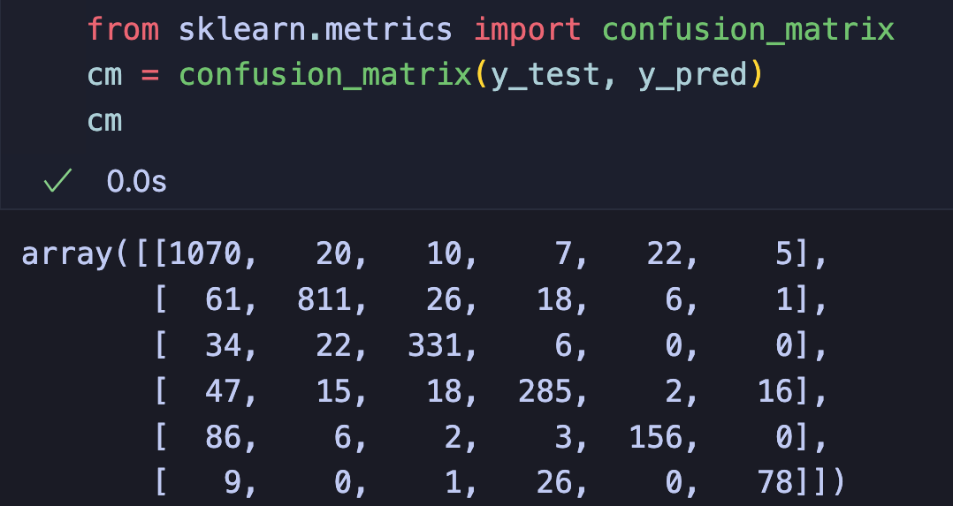
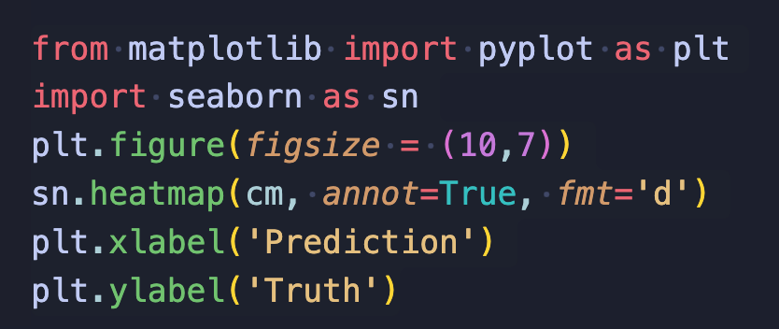
Confusion Matrix
With the following code we are getting graph representation of the confusion matrix that was shown before.
The confusion matrix provides insights into where the model is making correct predictions and where it may be making errors, helping you understand its strengths and weaknesses.

Slide 14
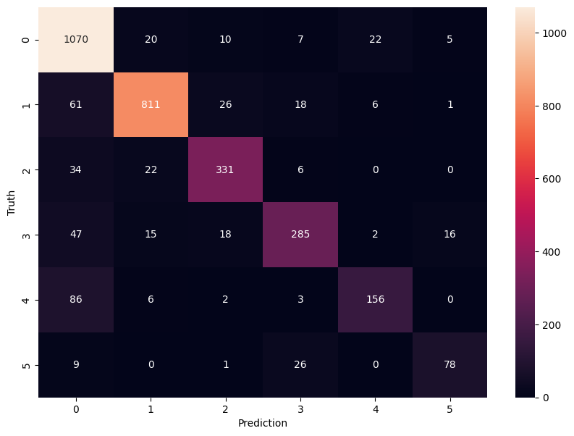
And the result is as follows

Slide 15
100
Make the program work with sound

Slide 16
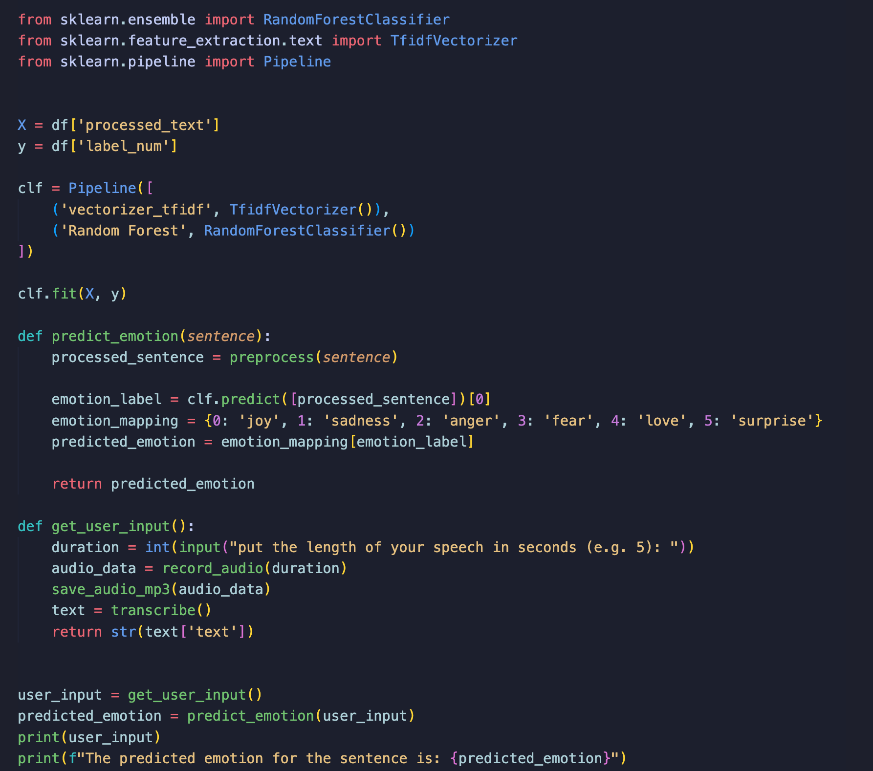
When the program runs it asks you for how long you want to speak first. When the string “Recording..” is printed the person must speak and the libraries that work with the microphone will catch the input and the audio will be saved to the temporary file inside of the project. Then the OpenAI whisper library is used to get this .mp3 file and transcribe it to the text
But before that there are other steps. The following code trains the model ‘clf’. The function ‘predict_emotion’ takes the model and user input and predicts the emotion there. The user input is gotten from the function get_user_input which calls for other functions which listen to audio, transcribe and return the text to the predict_emotion.

Slide 17
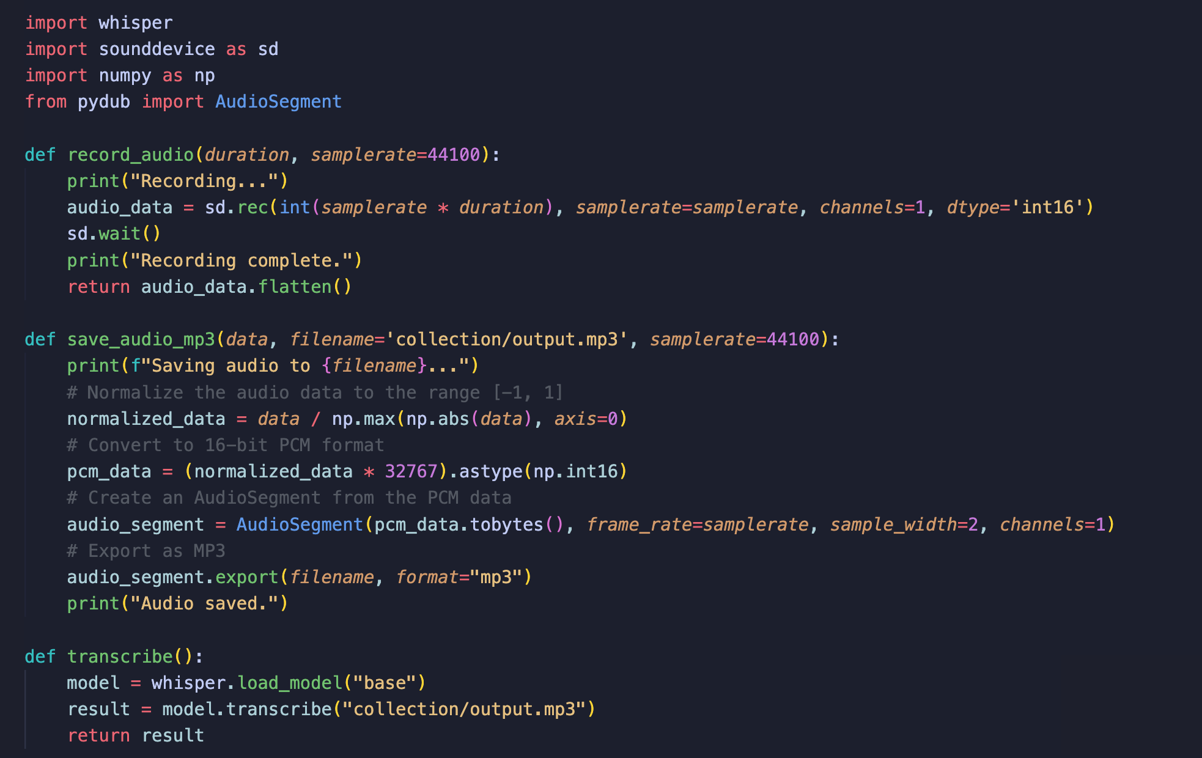
The audio functions look the following way:
The record_audio records the microphone and returns the audio file. The same audio is saved in format of .mp3 and later transcribed using the whisper. Which is used with the ‘base’ model.

Slide 18
101
Example of how the program works

Slide 19
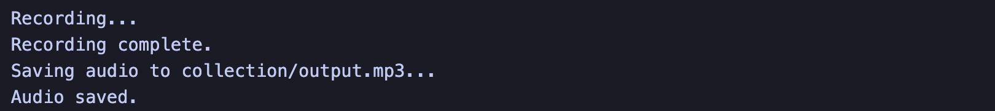

The last function as I said gives the result as emotion that is recognized in the speech you do. Here is the example of it to work:
Result:
P R O J E C T D E S C R I P T I O N

Slide 20
110
Literature

Slide 21
LITERATURE
dataset:
https://www.kaggle.com/datasets/abdallahwagih/emotion-dataset
explanation:
https://www.geeksforgeeks.org/understanding-tf-idf-term-frequency-inverse-document-frequency/
https://www.geeksforgeeks.org/random-forest-classifier-using-scikit-learn/
https://python-sounddevice.readthedocs.io/en/0.4.6/
https://www.youtube.com/watch?v=Pk29TV4VLEg&t=147s
https://www.w3schools.com/python/pandas/pandas_csv.asp
https://www.datacamp.com/tutorial/pandas-read-csv
https://scikit-learn.org/stable/modules/generated/sklearn.model_selection.train_test_split.html
https://spacy.io/models/en
https://github.com/openai/whisper

Slide 22
111
EMOTION RECOGNITION IN THE SPEECH

